Slide 1

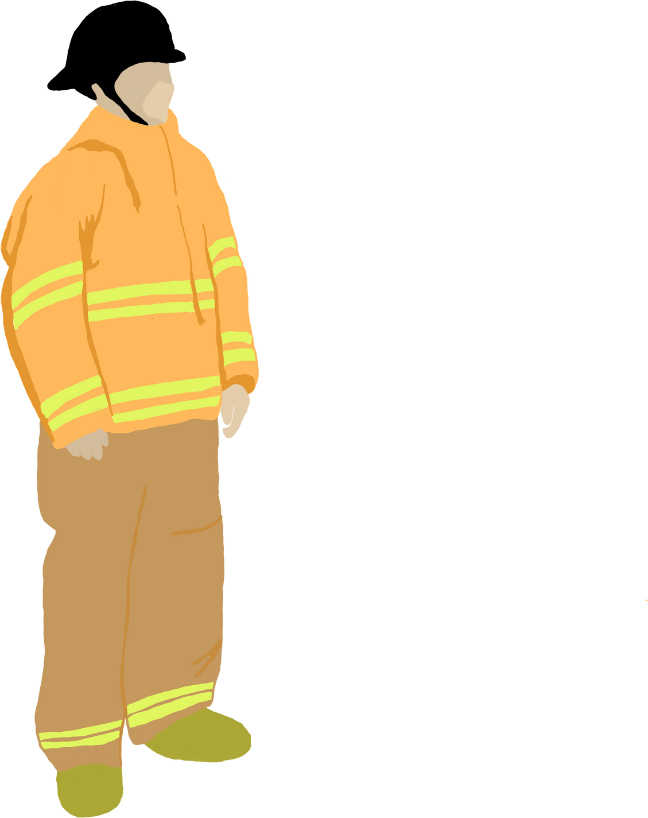

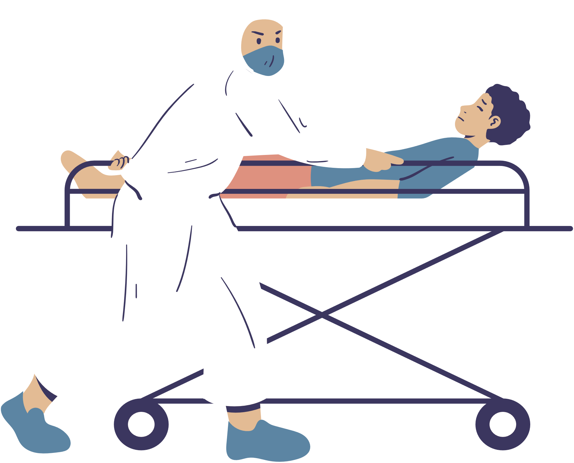


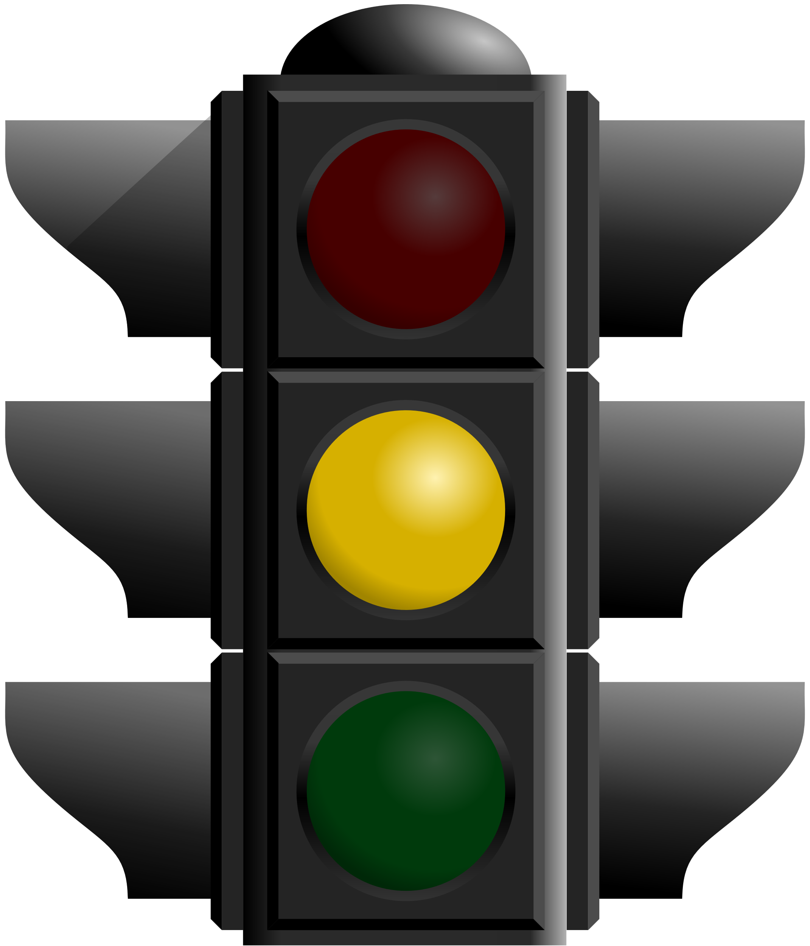



"Empowering Cities: AFR -ARC “Assist-Route Connect " Fusing tech like LoRa and camera analysis. It transforms urban safety. Real-time adjustments, human-tech collaboration, and potential life-saving impact shape a new era. AFR scales to urban needs, echoing wider smart city ambitions.
--- AFR-ARC
TEAM
Tons Of Tech!

Slide 2
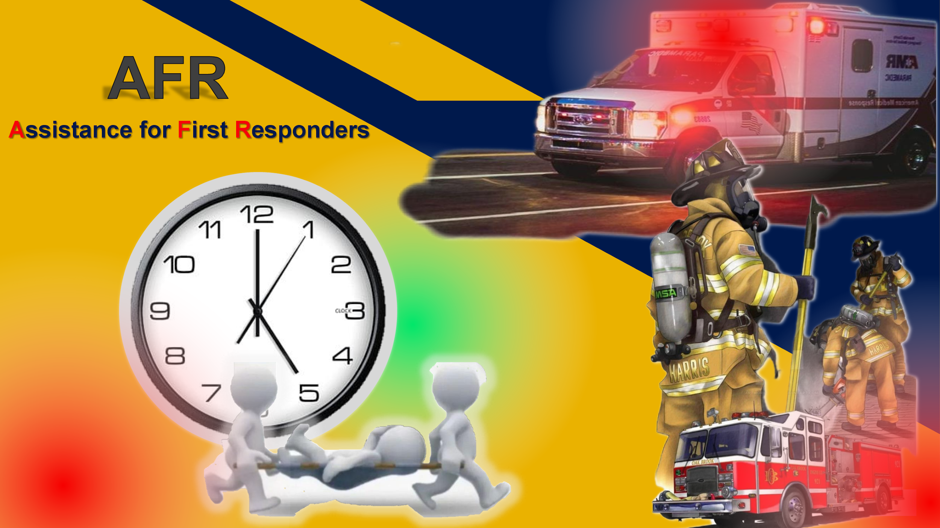
- ARC
OBJECTIVE
To create system for post-accident measures , so as to help reduce casualties related to road accidents

Slide 3

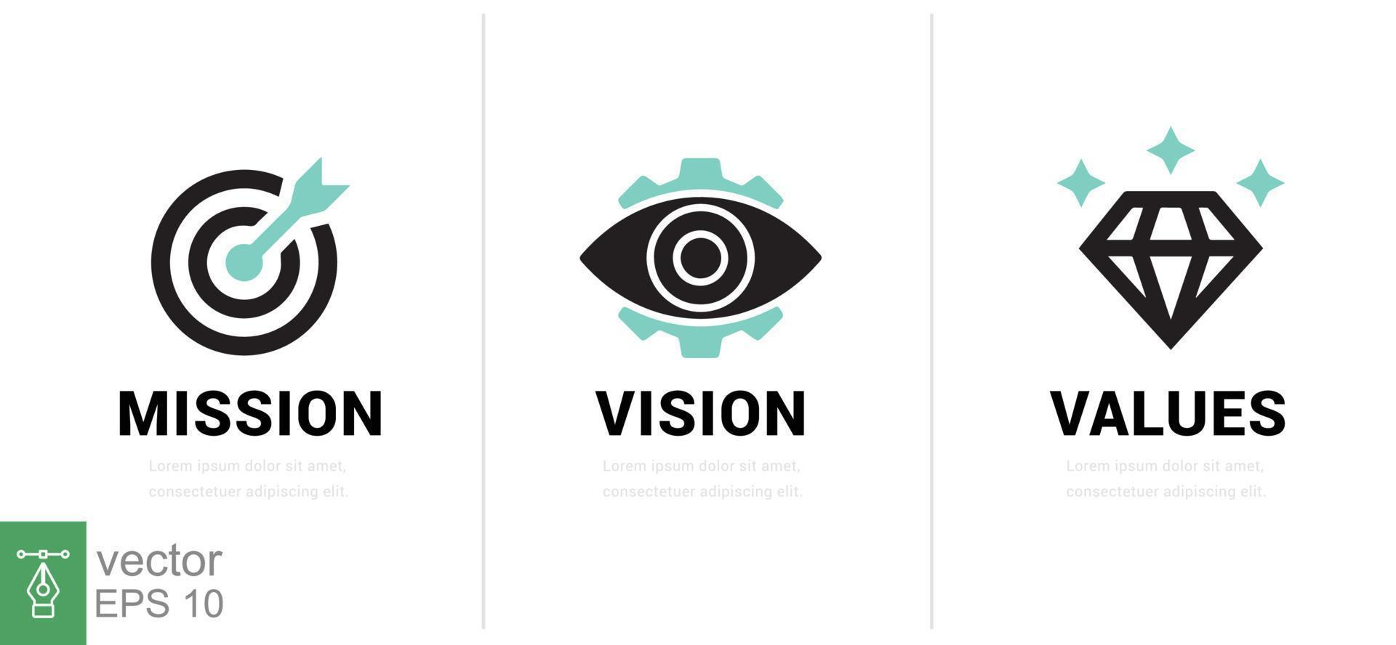
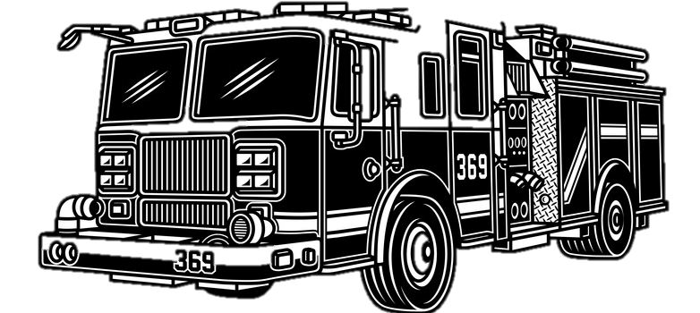


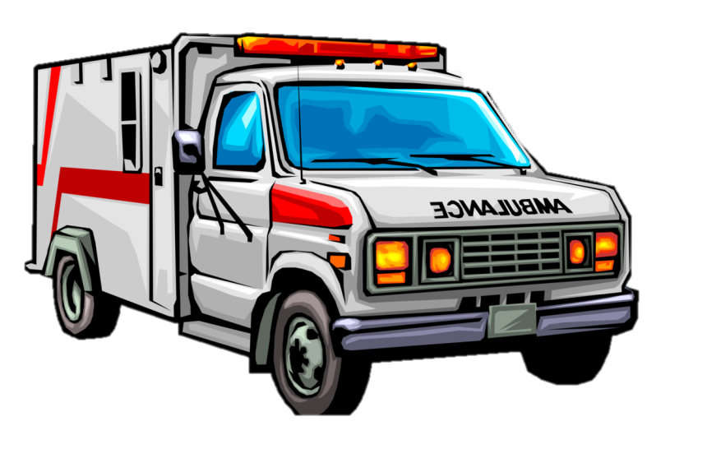
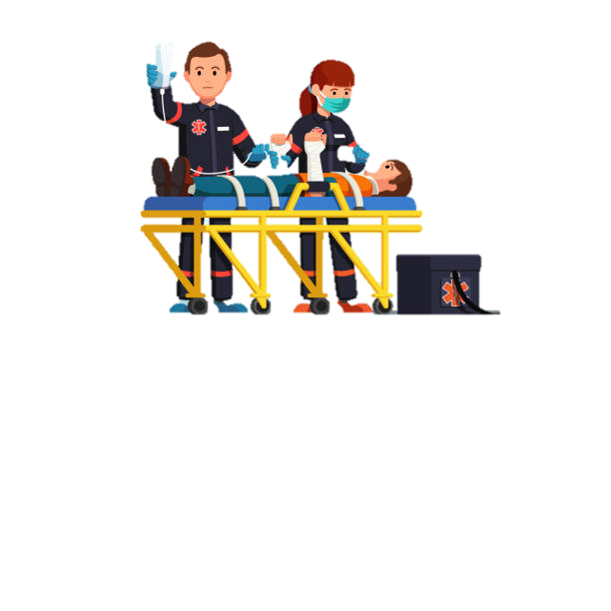
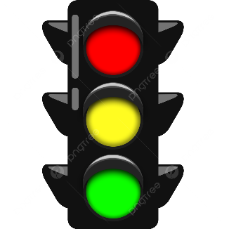
IMPORTANCE OF OUR IDEA!!..
Our project envisions a future where cutting-edge technology empowers emergency vehicles to navigate intersections seamlessly, enhancing public safety and reducing the traffic congestions.
Revolutionize traffic control using LoRa modules, optimizing emergency vehicle response time. Thereby saving the lives and reducing the traffic congestion which promotes public safety

Slide 4
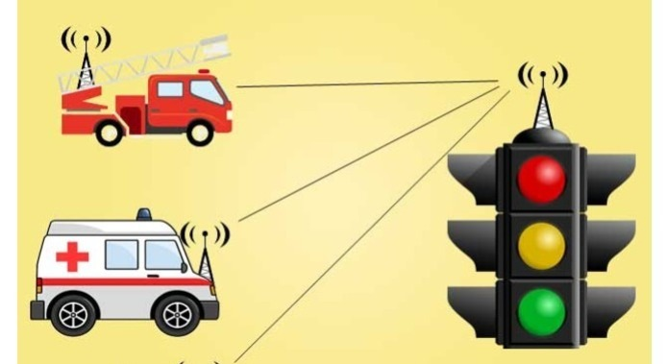

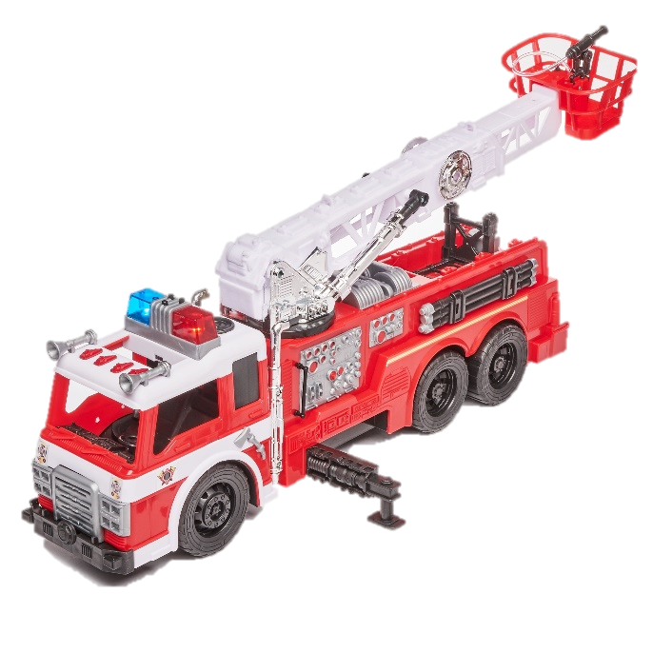
BLOCK DIAGRAM
EMERGENCY VEHICLE DETECTION:
LoRa communication detects approaching emergency vehicle.
TRAFFIC POLICEMAN INTIMATION:
Immediate notification to traffic policeman about incoming emergency vehicle.
MULTIPLE EMERGENCY VEHICLE CHECK:
Verify presence of multiple emergency vehicles on other lanes.
TRAFFIC DENSITY ANALYSIS (ESP-32 CAM MODULE):
ESP-32 camera modules (Den 1 and Den 2) analyze traffic density.
DENSITY COMPARISON:
Compare traffic densities from Den 1 and Den 2.
PRIORITY PASSAGE:
Grant priority passage to other lanes based on density comparison.
DYNAMIC LANE OPENING:
If multiple emergency vehicles detected, open lane with lower density.
TRUE
SINGLE EMERGENCY VEHICLE CASE:
If only one emergency vehicle, open respective lane for free flow.
FALSE

Slide 5
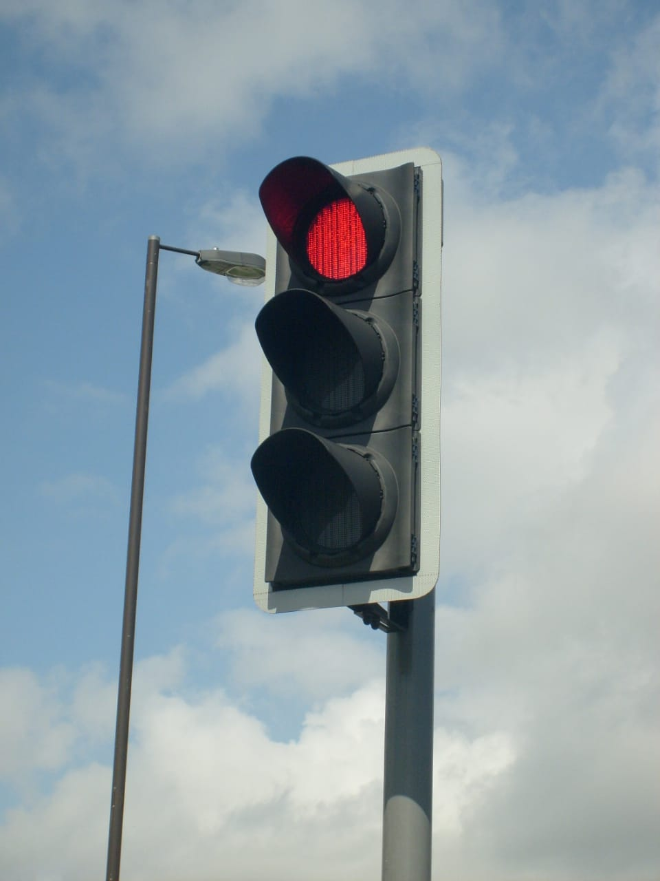
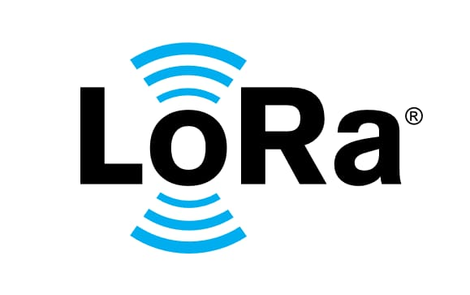
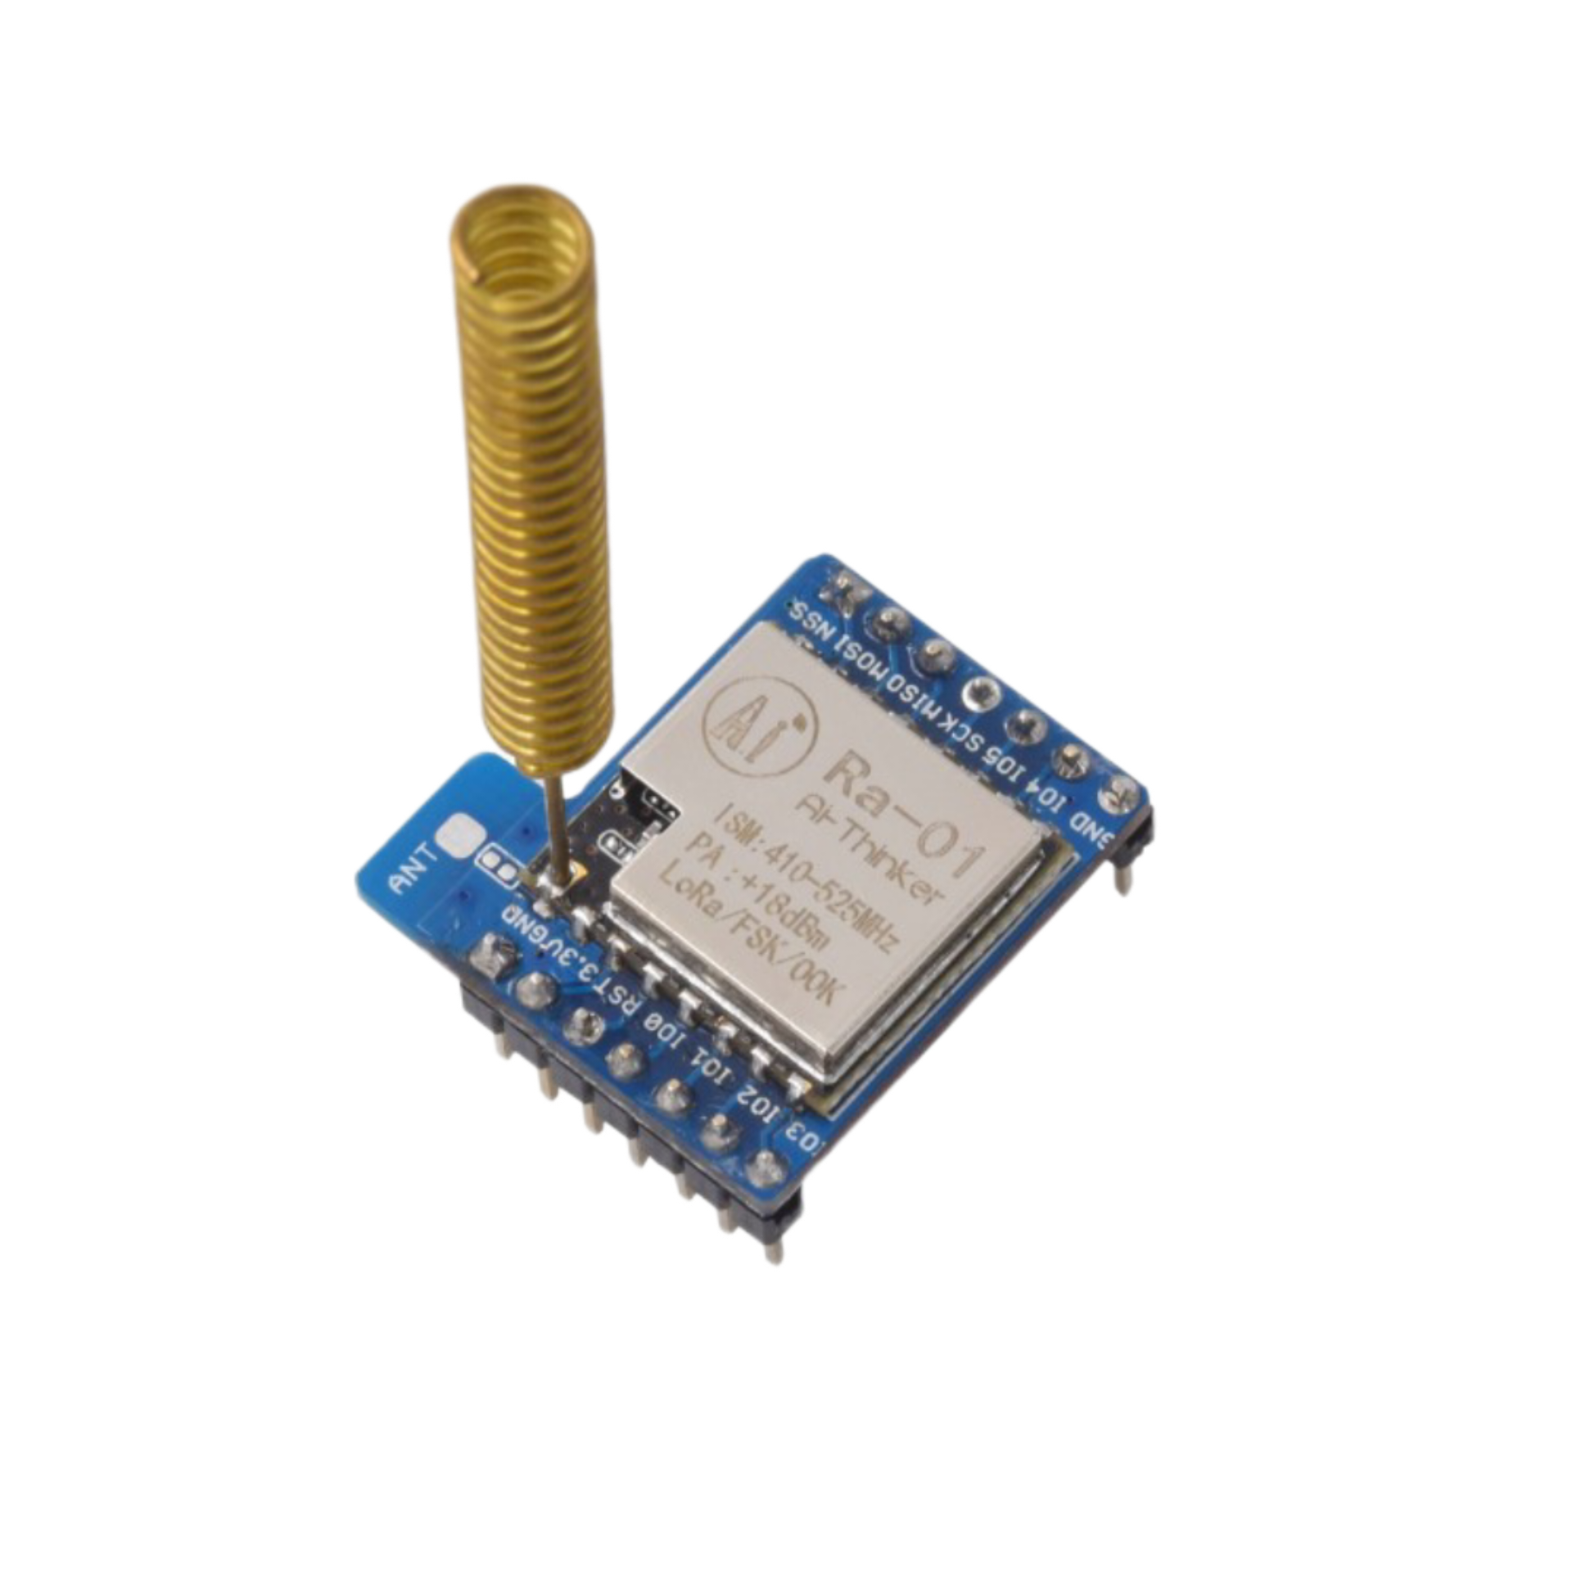
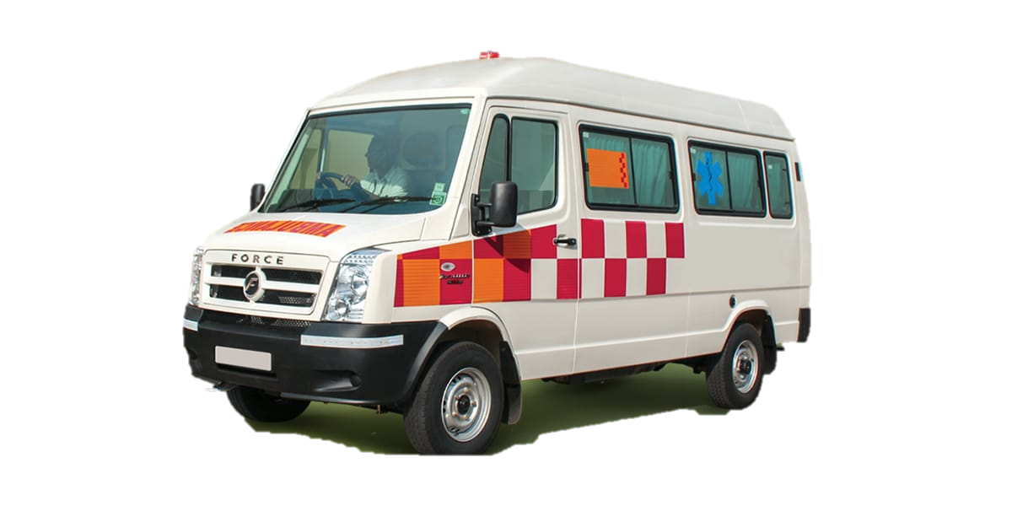
Ambulance arrival & detection by LoRa
Normal functioning of traffic signal
Green signal on detected lane
Ambulance pairing end
Other lanes RED
End-to-End
Pairing
Transmitter
Receiver

Slide 6
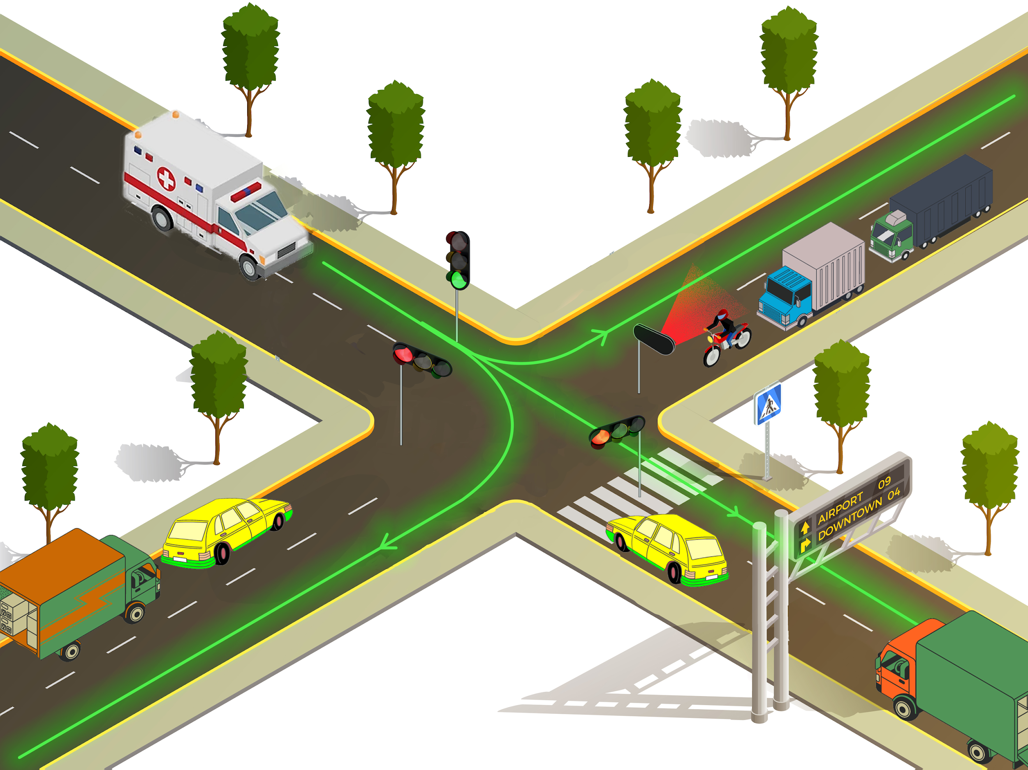
Notes:
SCHEMATIC REPRESENTATION AND {GENERAL DEPICTION}

Slide 7
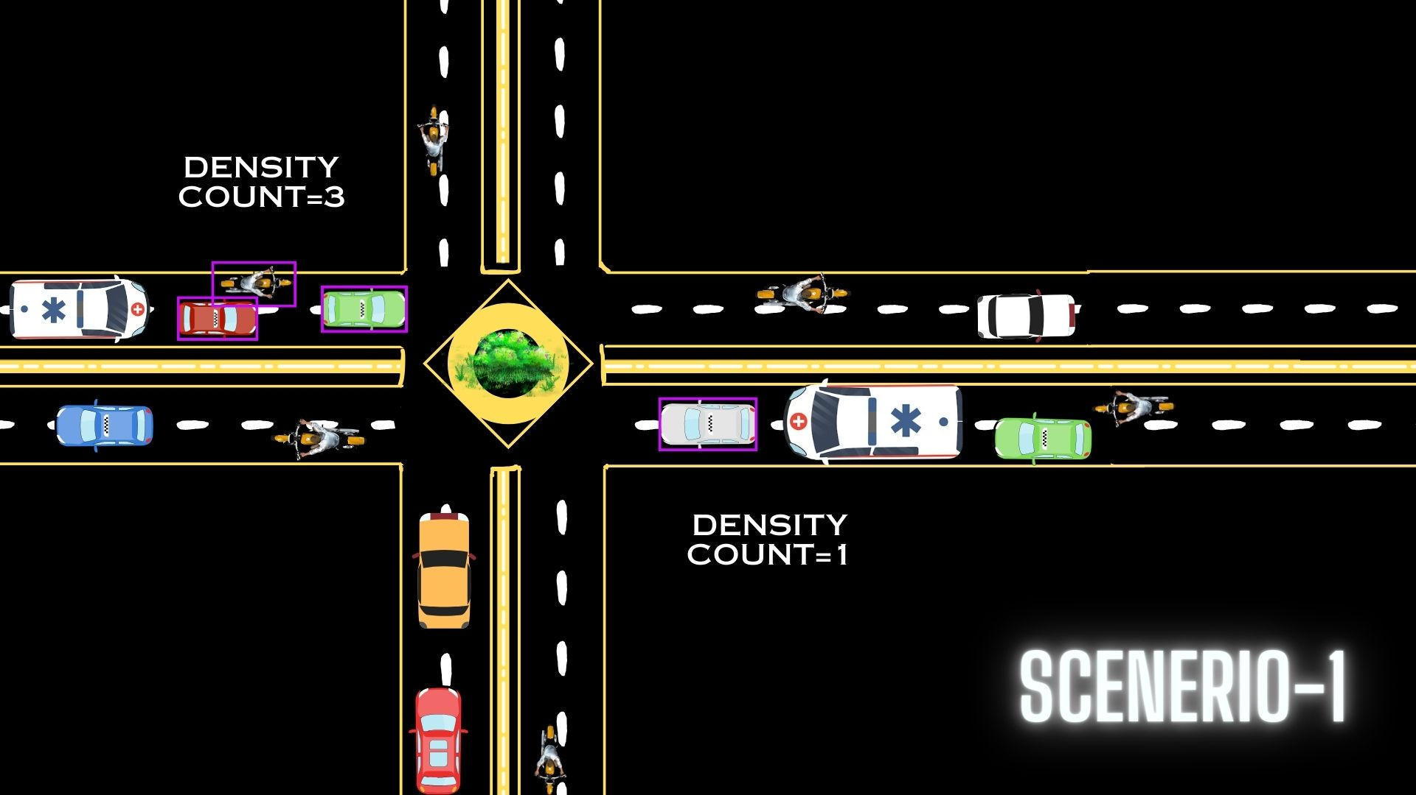
Notes:
SCHEMATIC REPRESENTATION AND {GENERAL DEPICTION}

Slide 8
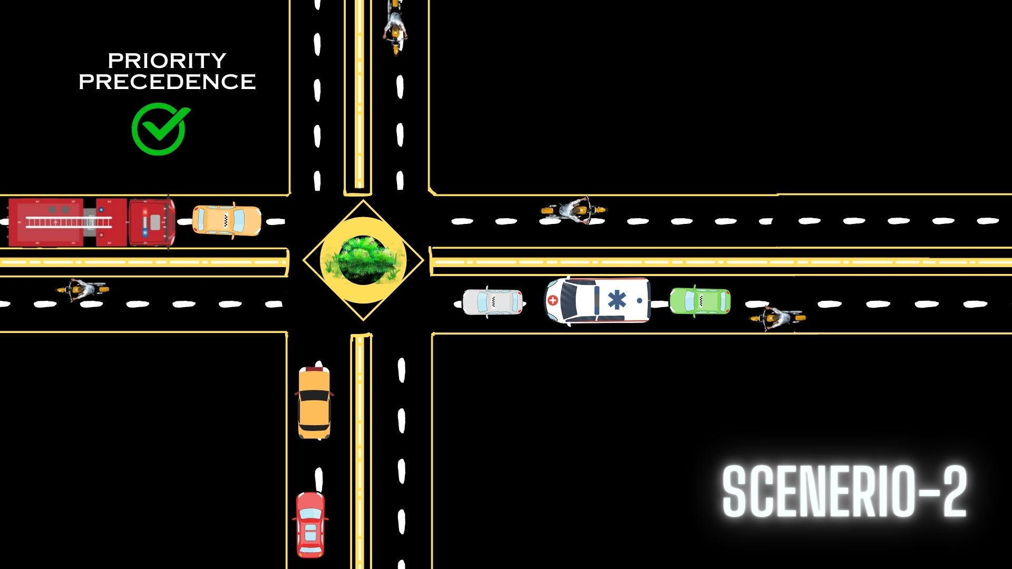
Notes:
SCHEMATIC REPRESENTATION AND {GENERAL DEPICTION}

Slide 9
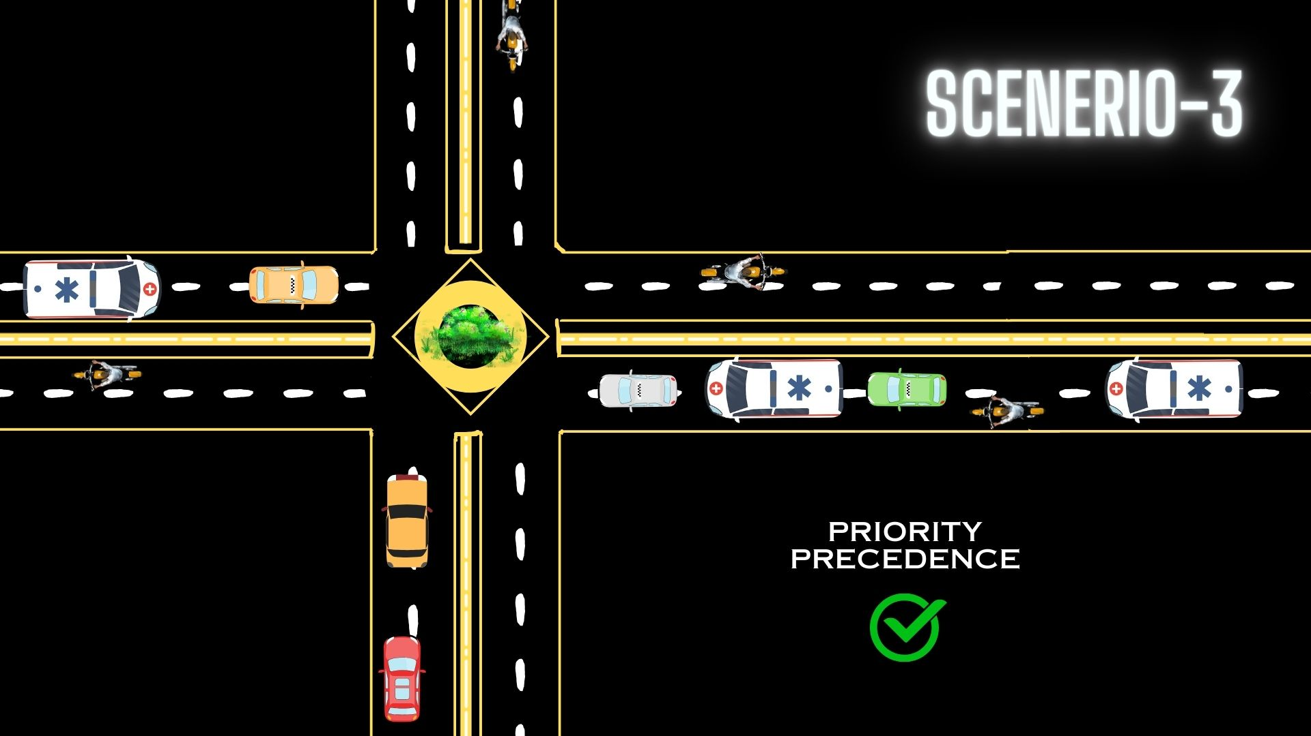
Notes:
SCHEMATIC REPRESENTATION AND {GENERAL DEPICTION}

Slide 10
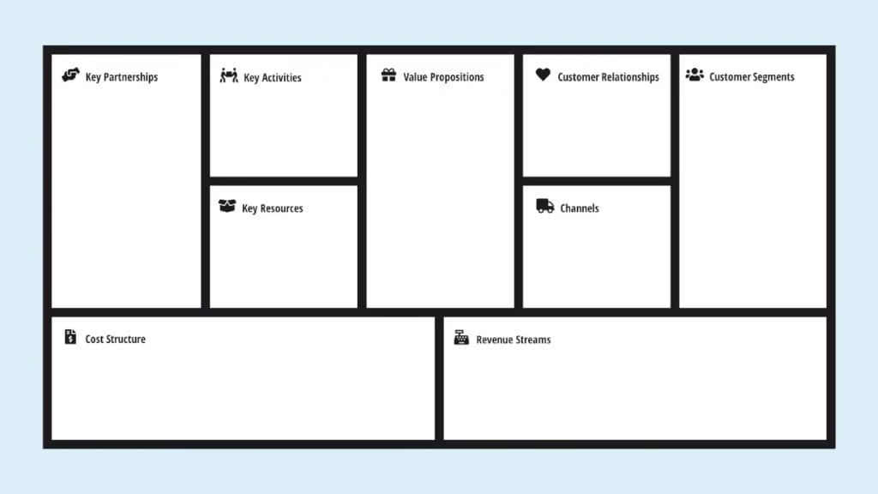
1.Emergency Services: Collaboration for real-time integration.
2.Traffic Authorities: Support for implementation and regulatory approvals.
3.Technology Providers: Suppliers of LoRa modules, cameras, microcontrollers.
1.Technology Development: Design and refine LoRa communication, signal alteration, and routing algorithms.
2.Collaboration: Engage with emergency services and traffic authorities for successful implementation.
1.Enhanced Emergency Response: Swift ambulance passage through synchronized signals.
2.Traffic Flow Optimization: Reduced congestion and improved traffic management
3.Safer Cities: Minimized response times and smoother traffic flow for safer urban environments.
1.Consultative: Working closely with emergency services and traffic authorities to tailor solutions.
2.Support: Continuous technical support and assistance.
1.Emergency Services: Quicker response times and improved patient care.
2.Traffic Authorities: Efficient traffic management and congestion reduction.
3.General Public: Safer roads, reduced congestion, and improved urban mobility.
1.Technology Expertise: Skilled professionals in communication technology, programming, and AI.
2.Infrastructure: Required hardware and software components for AFR implementation.
3.Partnerships: Strong collaboration with emergency services and traffic authorities.
1.Direct Sales: Collaborations with emergency services and traffic authorities.
2.Online Platforms: Educational resources, demos, and updates.
3.Workshops and Seminars: Awareness and knowledge sharing with stakeholders
1.Research and Development: Investment in technology and algorithm development.
2.Hardware and Software: Costs associated with components and licenses.
3.Operational Costs: Maintenance, technical support, and employee salaries.
1.Product Sales: Revenue from selling AFR system and required hardware.
2.Subscription Model: Recurring revenue for maintenance and updates.
3.Consulting Services: Providing implementation and customization services.
(Kindly checkout the BOM of the sample prototype, attached on the following page)

Slide 11
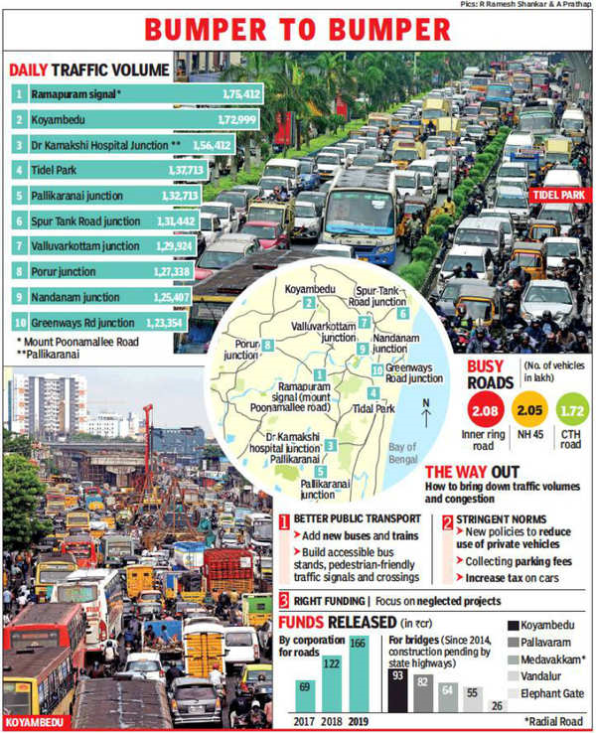
TRAFFIC ANALYSIS:
The Ramapuram traffic signal on Poonamalle High Road is officially the most congested junction in Chennai, according to data collected by Chennai Metro Rail Limited (CMRL) for expansion work. On an average, more than 1.75 lakh vehicles cross this junction.
Intersections in front of Kamakshi Hospital at Pallikaranai near Chennai One Tech Park (1.56 lakh),Tidel Park at Taramani(1.37 lakh), Perumbakkam-Pallikaranai (1.32 lakh) and below Porur flyover (1.27 lakh) are among the top 10 congested junctions.

Slide 12
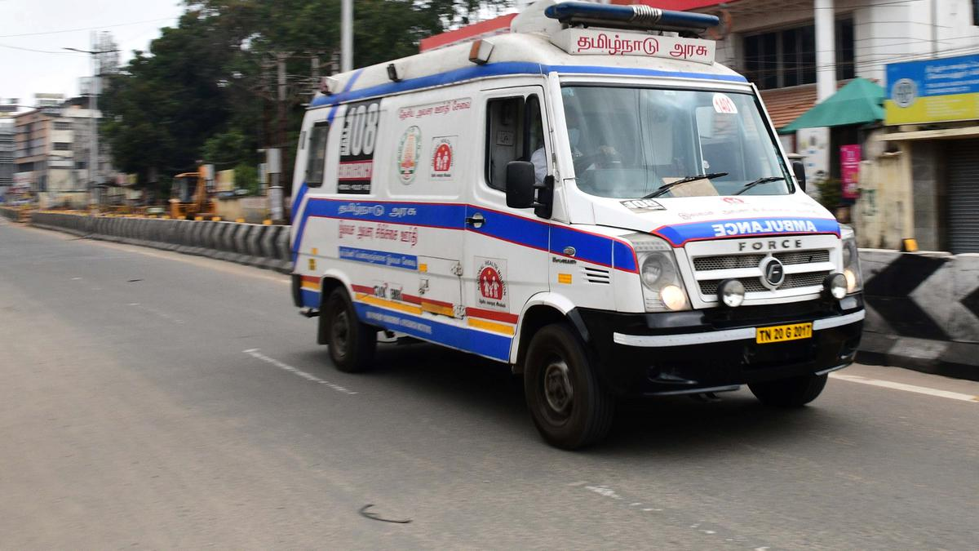
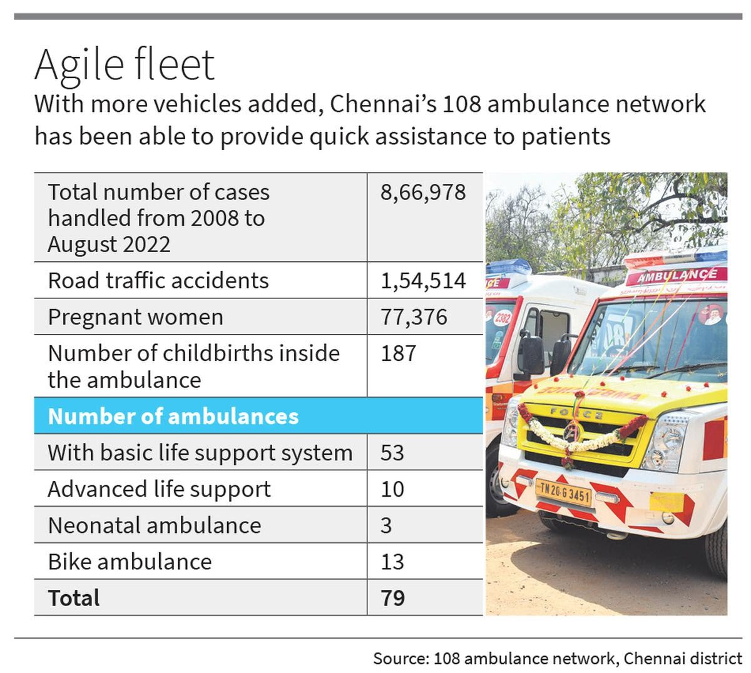
REPORT ON AMBULANCE SERVICE :
The 108 Ambulance Service saw an average of 5,259 users per day in Tamil Nadu in 2023. According to officials, a total of 1,353 ambulances are being operated across the State. This included basic, intensive care, and infant ambulances, and first-aid bike ambulances. Data show that 19,19,504 people across Tamil Nadu benefited from the ambulance service in 2023. This is an increase of nearly 1.44 lakh compared to 2022, when 17,74,832 used the service across the State.
Chennai had the highest number of beneficiaries who utilised the 108 Ambulance Services in Tamil Nadu during 2023. A total of 1,05,961 people utilised the services in the city, followed by its neighbouring district of Tiruvallur, while Coimbatore took the third spot

Slide 13
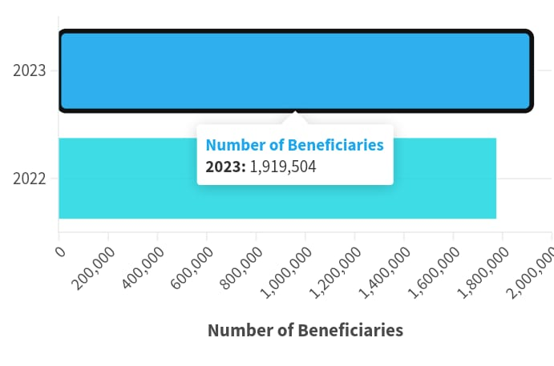
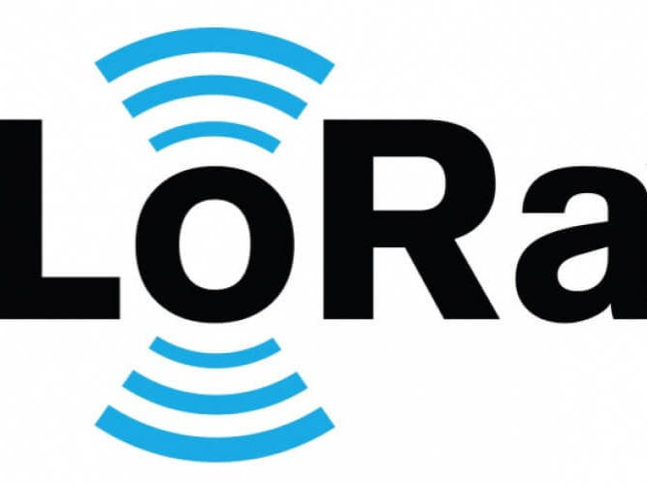
EMERGENCY VEHICLES USER BENEFITS:
An analysis of last year’s data showed that of the over 19 lakh beneficiaries in 2023, 5,07,071 were pregnant women. A total of 3,34,527 people injured in road accidents were assisted by the service - an average of 917 persons per day. As many as 1,19,738 heart patients also benefited. The network served 10,943 children, while a total of 22,450 infants were transported to hospitals for treatment in special ambulances for infants in 2023, said M.Selvakumar, State Head of Operations, EMRI Green Health Services (GHS), which operates the ambulance network in Tamil Nadu. The ambulance network has a response time of 8 to 10 minutes in Chennai, while the State average is 13 minutes.
LoRa Advantages:
LoRa enables long –range communication , allowing devices to transmit data.
It will not interference with other wireless signals. The data rate of LoRa can be configured maximum at 243kbps and can be minimized to 11bps

Slide 14

AFR-Tx
ITEM | QUANTITY | PRICE PER QTY(in rupees) | TOTAL PRICE
LoRa SX1276 | 1 | 474 | 474
Arduino Nano | 1 | 270 | 270
Indication LEDS | 2 | 5 | 10
Power source (5V Battery) | 1 | 60 | 50
Antenna 433 MHz | 1 | 65 | 65
 |  | TOTAL | 869

Slide 15
AFR-Rx
ITEM | QUANTITY | PRICE PER QTY(in rupees) | TOTAL PRICE
LoRa SX1276 | 1 | 474 | 474
Arduino Nano | 1 | 270 | 270
Indication LEDS | 2 | 5 | 10
Power source (5V Adapter) | 1 | 60 | 60
Antenna 433 MHz | 1 | 65 | 65
 |  | TOTAL | 879

Slide 16

a
ARC- Kit
ITEM | QUANTITY | PRICE PER QTY(in rupees) | TOTAL PRICE
ESP 8266 | 1 | 165 | 165
ESP 32 CAM | 1 | 480 | 480
BMP 180 Altitude Sensor | 1 | 84 | 84
Battery (6V) 2X AAA Rechargeable battery | 1 | 200 | 200
 |  | TOTAL | 929

